Slide 1
OneSource Overview

Slide 2
Premier Contracted Supplier Contract Number PP-FA-974 Electrical Products Effective May 1st, 2022
Electrical Supplier
$150M Local Inventory in Southern California
Robust services offering, including energy solutions
Digital business tools supported by live customer service
Reference: https://www.1sourcedist.com/services/service/premier-contracted-supplier

Slide 3
OneSource Services & Solutions
Lighting
EV Charging
Vendor Managed Inventory
Mobile App
Digital Business Solutions
Energy Sustainability Solutions
Cybersecurity
Power Reliability Solutions
Siemens Panelboard Assembly
Assembly and Manufacturing
Logistics
Safety Services
Variable Frequency Drive Validation
Pro Logistic Services
Training & Events
Reference: https://www.1sourcedist.com/services

Slide 4
Logistics
Download Logistics Brochure
Delivery when you need it
Increased AM appointment delivery times
Same day delivery available
Whether you need a boom truck, a truck with a forklift or a flat body truck, OneSource provides the right truck for the right application
Storage Lockers
Gives you access to your orders 24/7
Place your order on our website or mobile app—receive a notification when your order is ready
If you order before 7 PM, you can pick up your order the next day

Slide 5
Mobile App
iOS or Android
Scan & order with barcode scanner
Search, browse & order products
Website Solutions Videos: Account Dashboard Orders & Quotes Product Groups Frequently Purchased Products Import Order
Digital Job Center
Delivery Notifications

Slide 6
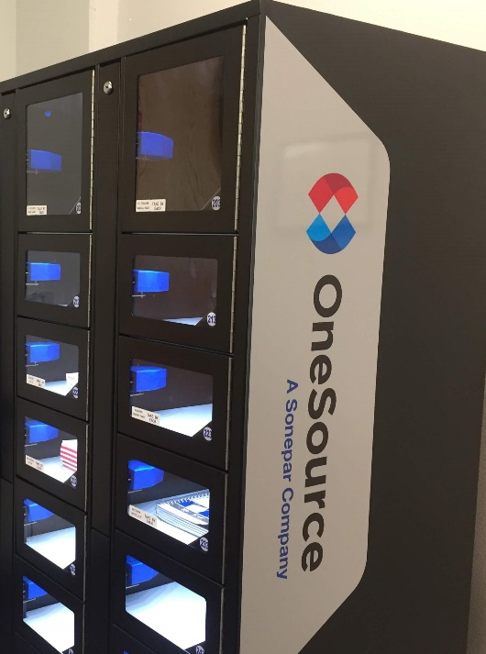
Vendor Managed Inventory
Download SureStock VMI Brochure
OneSource SureStock™ Customized, straightforward, and time-saving VMI solutions
Increase your productivity and efficiency by eliminating time spent on materials handling
We regularly update lead times, measure your supply chain performance, recalculate your stock level requirements and provide cutting-edge vending solutions
Scanning
We use connected devices to collect inventory levels and trigger ordering
Our team schedules scans that suit your needs and support spot buying for production increase. Scans are shared wirelessly with our network for quick turnaround
Organization
Our team will identify, label, arrange and organize all applicable inventory
We do regular inventory reviews with service stock in our facilities for high demand items
Vending
Tailored to fit your needs, choose from traditional vending, carousel/locker vending and passive vending
We provide full analytics, reporting and customization of the data flow
Full Service Toolcrib
We provide full resource management and onsite staff to suit your needs and budget
Our team integrates a service queue ticketing system to manage request

Slide 7
LIGHTING
SOLUTIONS
Services
Key Partners
Lighting audit
Design-build support
CAD design assistance
Point-by-point layouts
Controls design & integration
Energy savings analysis
Acuity Lithonia
Cooper Lighting
Lutron Controls
LEDVance
Nicor Lighting

Slide 8
Products
Services
EV Charging
Level 2 and level 3 applications
Parking lot and fleet solutions
Aligned with best-in-class manufacturers
Solar
Roof top or car port
Battery storage systems to manage demand during peak hours
Microgrid
On-site solar, storage, and power generation
Consulting, Design, and Specification
End-to-end consulting, design, and specification for comprehensive clean energy system
Turnkey Solutions
Design and build, procurement of hardware and software, project management for installation, and financing
Project ROI
Analysis for lucrative green investment
Complete analysis of available grants, rebates, and incentives
Financing
Project financing solutions available

Slide 9
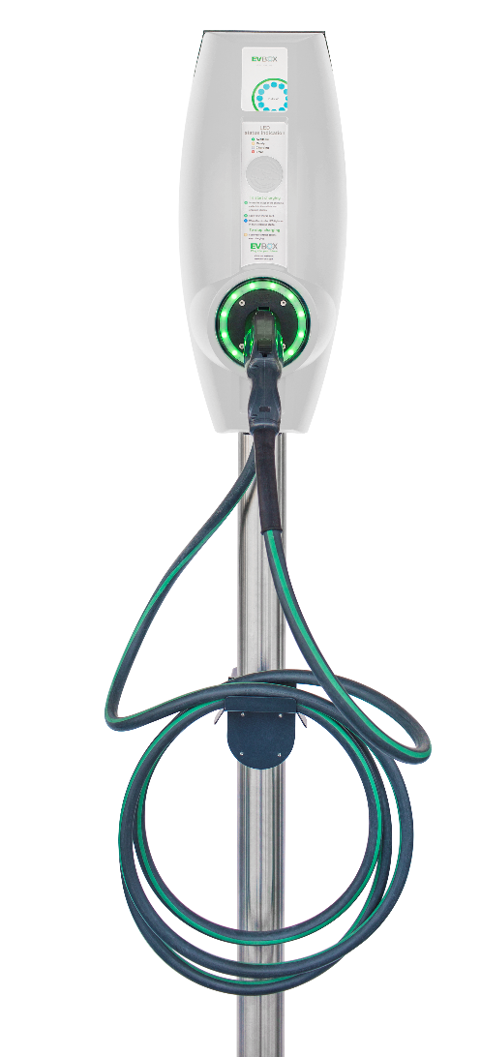
EV Charging Solutions
Download EV Charging Brochure
Your one-stop partner
Meet government requirements for EV charging spaces, along with increasing demand
Full solutions for contractor and industrial customers
Turnkey solutions for
Full project management based on industry best practices
Expert knowledge of energy codes and the products you need to fulfill requirements
Understanding of all available rebates and full rebate claim management
Fast and reliable delivery dates
Warehousing and full project delivery
Partnerships with leading hardware and software providers
Ensure that your job gets done on time, that it’s up to code, that you have leveraged all available rebates
Know your hardware is ready today the software you’ll need to install tomorrow, and that you won’t exceed the capacity of your electrical infrastructure
Whether you’re looking to power your fleet or take advantage of an EV charging station revenue stream, OneSource is the partner you can trust to do it right

Slide 10
About OneSource Distributors
Founded in 1983, joined the Sonepar Group in 2011
$1B annual revenue
500+ employees
15 locations in California, Hawaii, Arizona, Baja California
1 Central Distribution Center (CDC) in Fullerton
Utility, Commercial Contractor, Solar, Industrial, Institutional
ISO 9001:2008 14001, CSA & ATEX, 2003 UL 508 Certified

Slide 11
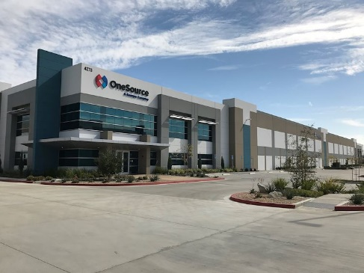
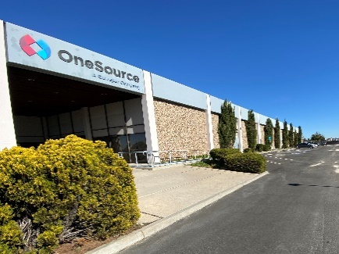
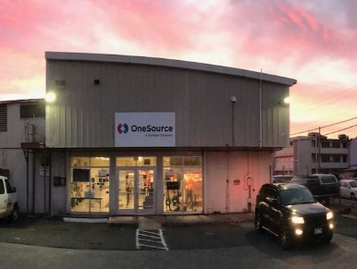
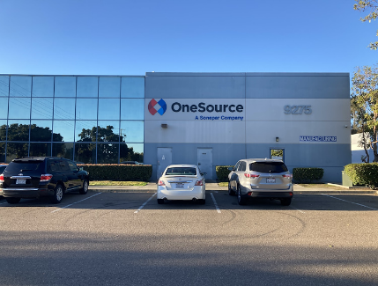
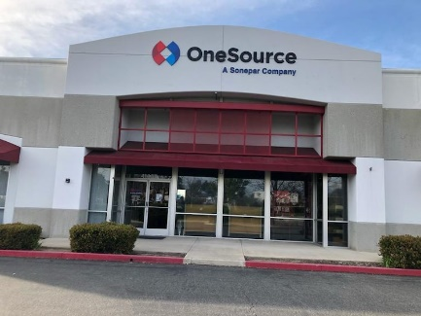
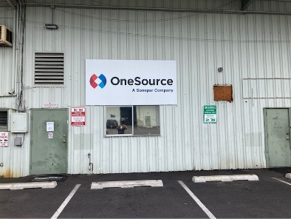
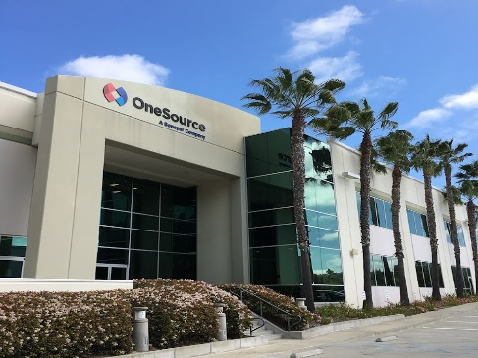
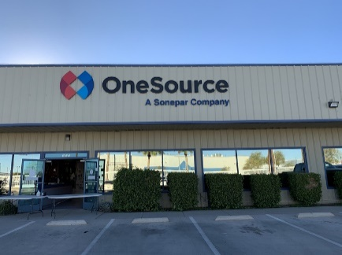
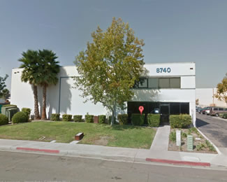
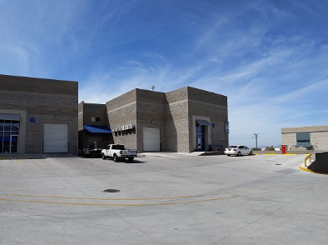
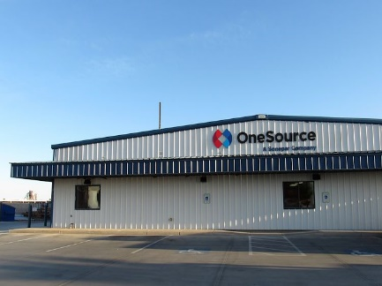
CDC's and Warehouses (non-Utility)
CDC & RDC
Warehouses (CA/AZ/HI/MX)
Manufacturing/Ind.
Br36 – San Diego, CA
Xfers from Br99 crossed @ Br1 (Daily)
19,560 sq ft
Br39 – Temecula, CA
Xfers from Br99 crossed @ Br1 (Daily)
15,000 sq ft
HI1 – Honolulu, HI
35,000 sq ft
Br3 – Miramar Assembly & Manufacturing
Contract Manufacturing, Subassembly, Kitting, Testing, Labeling, Repacking
20,000 sq ft
Br99 – Fullerton, CA
Main CDC/Logistics Hub
212,000 sq ft
Br5 – El Centro, CA
Xfers from Br99 (weekly)
8,600 sq ft
HI5 – Kona, HI
17,000 sq ft
Br1 – Oceanside, CA
Corporate Office
Utility/Manufacturing/Lighting
75,000 sq ft
Br7 – Yuma, AZ
Xfers from Br99 crossed @ Br5 (weekly)
9,800 sq ft
DD5 – Otay Cutting Tools
Application specific cutting tools and complete tool management.
9,264 sq ft
Br6 – Tijuana, MX
Xfers from Br99 cross @ Br1 (Mex. Supply)
6,500 sq ft

Slide 12
Key Suppliers

Slide 13
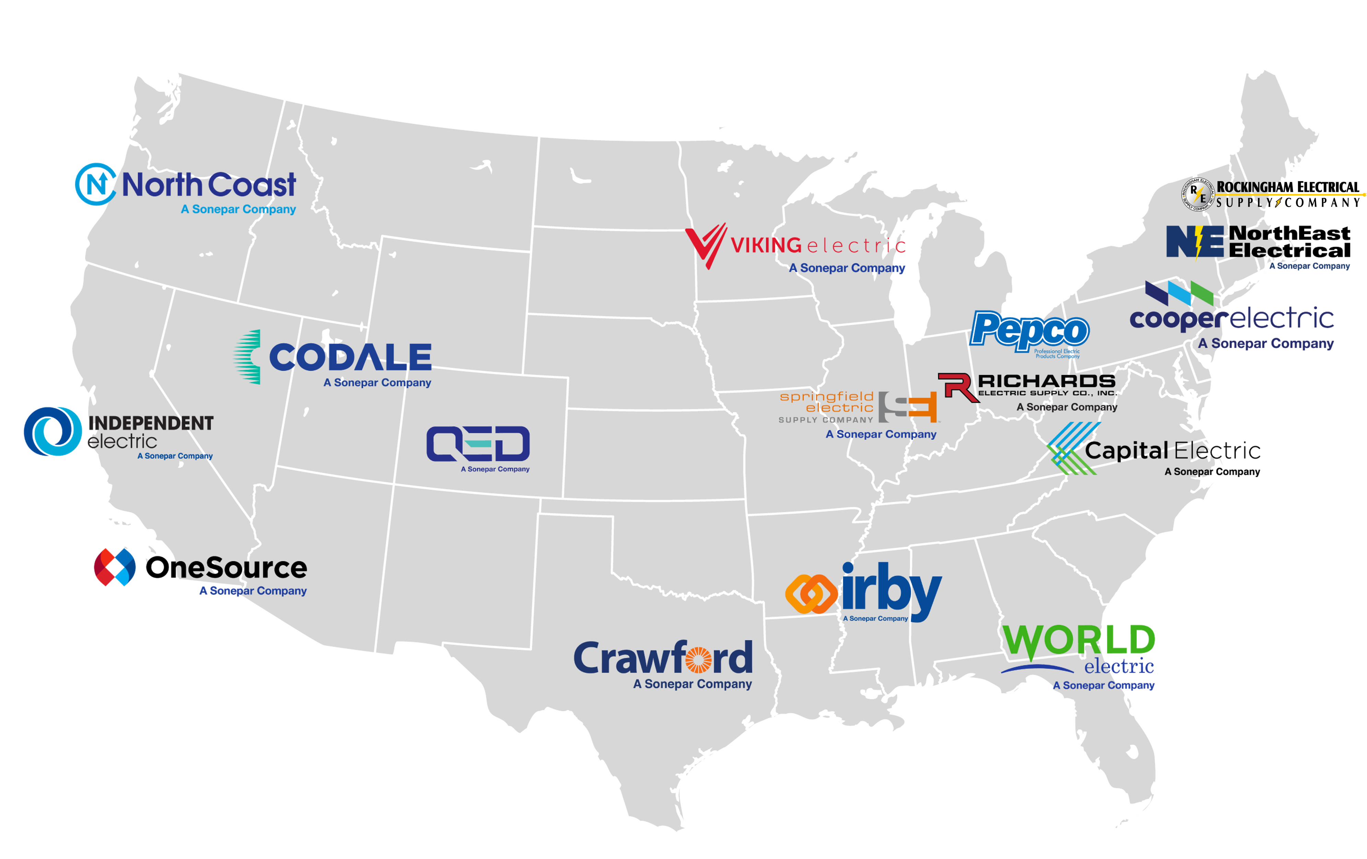
About Sonepar
Global market leader in electrical distribution
Independent family-owned company
Based in France, operating in 44 Countries
165+ operating companies, 2800+ branches
45,000 associates
$25B Annual Revenue
Sonepar US HQ in South Carolina
18 Operating Companies in USA

Slide 14
Notes:
DO NOT DELETE! This is an animated GIF. View in presentation mode to see logo animation. Or, you can copy it to any slide.

