Slide 1

Allied USA
About Us.

Slide 2
About Us
Allied is the largest privately held medical waste disposal company with over 11,000 unique customer locations in all 50 states. We help manage and dispose of all waste streams, from simple sharps service to highly regulated hazardous waste,
ensuring compliance with all relevant regulations and standards.
Founded in 1977, we are a family-owned business that ventured into the medical waste sector in 2011 through a strategic acquisition. Allied's nationwide success is fueled by our steadfast "customer-first" approach. We proudly uphold our commitment to swift response times, providing multiple direct points of contact to ensure unparalleled service excellence and response time

Slide 3
Medical Waste Services

Slide 4
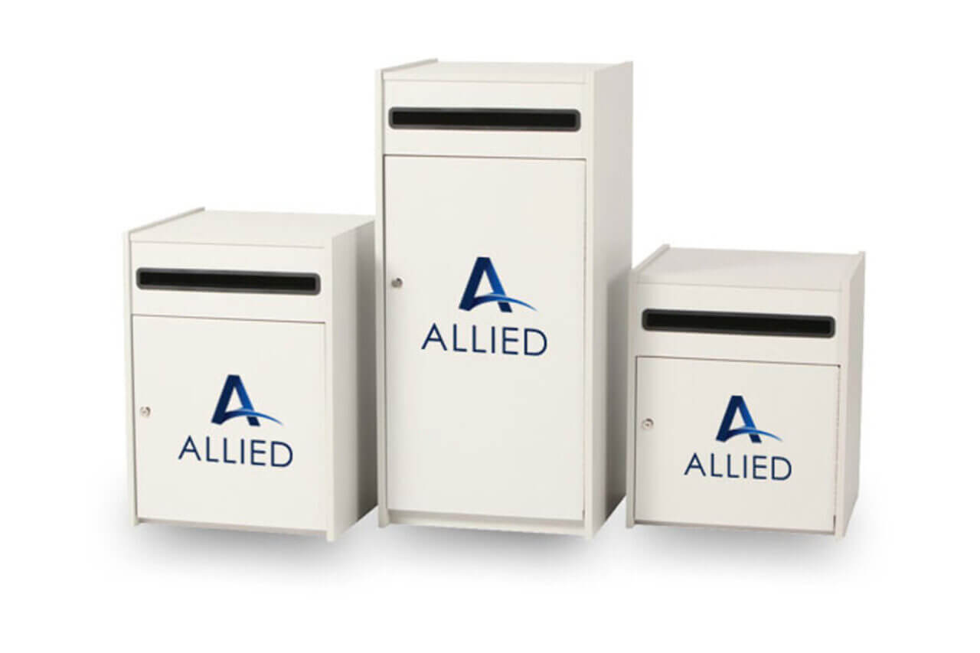
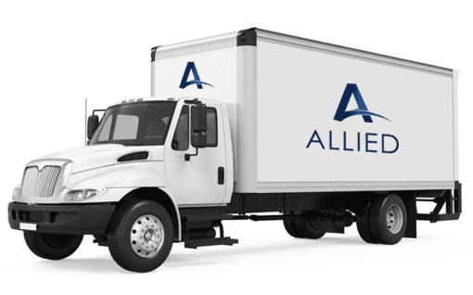
Secure Document Shredding
Overview of services:
Size of Shredding Containers
  Standard Executive Console: 30g
  Mini Executive Console: 19g
  Totes: 64g – 96g
Advantages:
  Protect Confidential & Sensitive Patient Information
  Comply with Privacy Laws (HIPAA, GDPR
  Can bundle with Medical Waste Services

Slide 5
Why Allied?
Nation-wide Coverage
Competitive Pricing
High Level Customer Service
Dedicated Account Representative
Customized Billing Options
Compliant with Federal and State Regulations
Safe Disposal Practice
Customizable Service Plans for Different Facility Sizes

Slide 6
Introducing Our Online Portal
Overview of Features:
  Easy access to OSHA training modules for staff
  Digital tracking of manifests and pick-up schedules
Convenience:
  24/7 access to training and scheduling
  Streamlined communication and record-keeping
Compliance:
  Ensures your team stays up-to-date with OSHA certifications
  Access to historical records and manifests

Slide 7
Current Clients:
800 locations nationwide
MB2 Website
Heartland Dental – Dental Support Organizations
1900 locations nationwide
Heartland Website
Veterinary Emergency Group – 24-hour Veterinary Emergency Clinics
125 locations nationwide
VEG Website
Ensign Group – Skilled & Assisted Nursing Facilities
259 locations nationwide
Ensign Wesbite
MB2 – Dental Support Organizations

Slide 8
Contract Buyout Process
Customer will hand in cancellation letter to current vendor. Once Customer receives the final invoice from current vendor – forward it to Allied team for review.
Once approved by Allied – Allied will issue a check or ACH payment to Customer.
Allied contract will then go into place.

