Slide 1
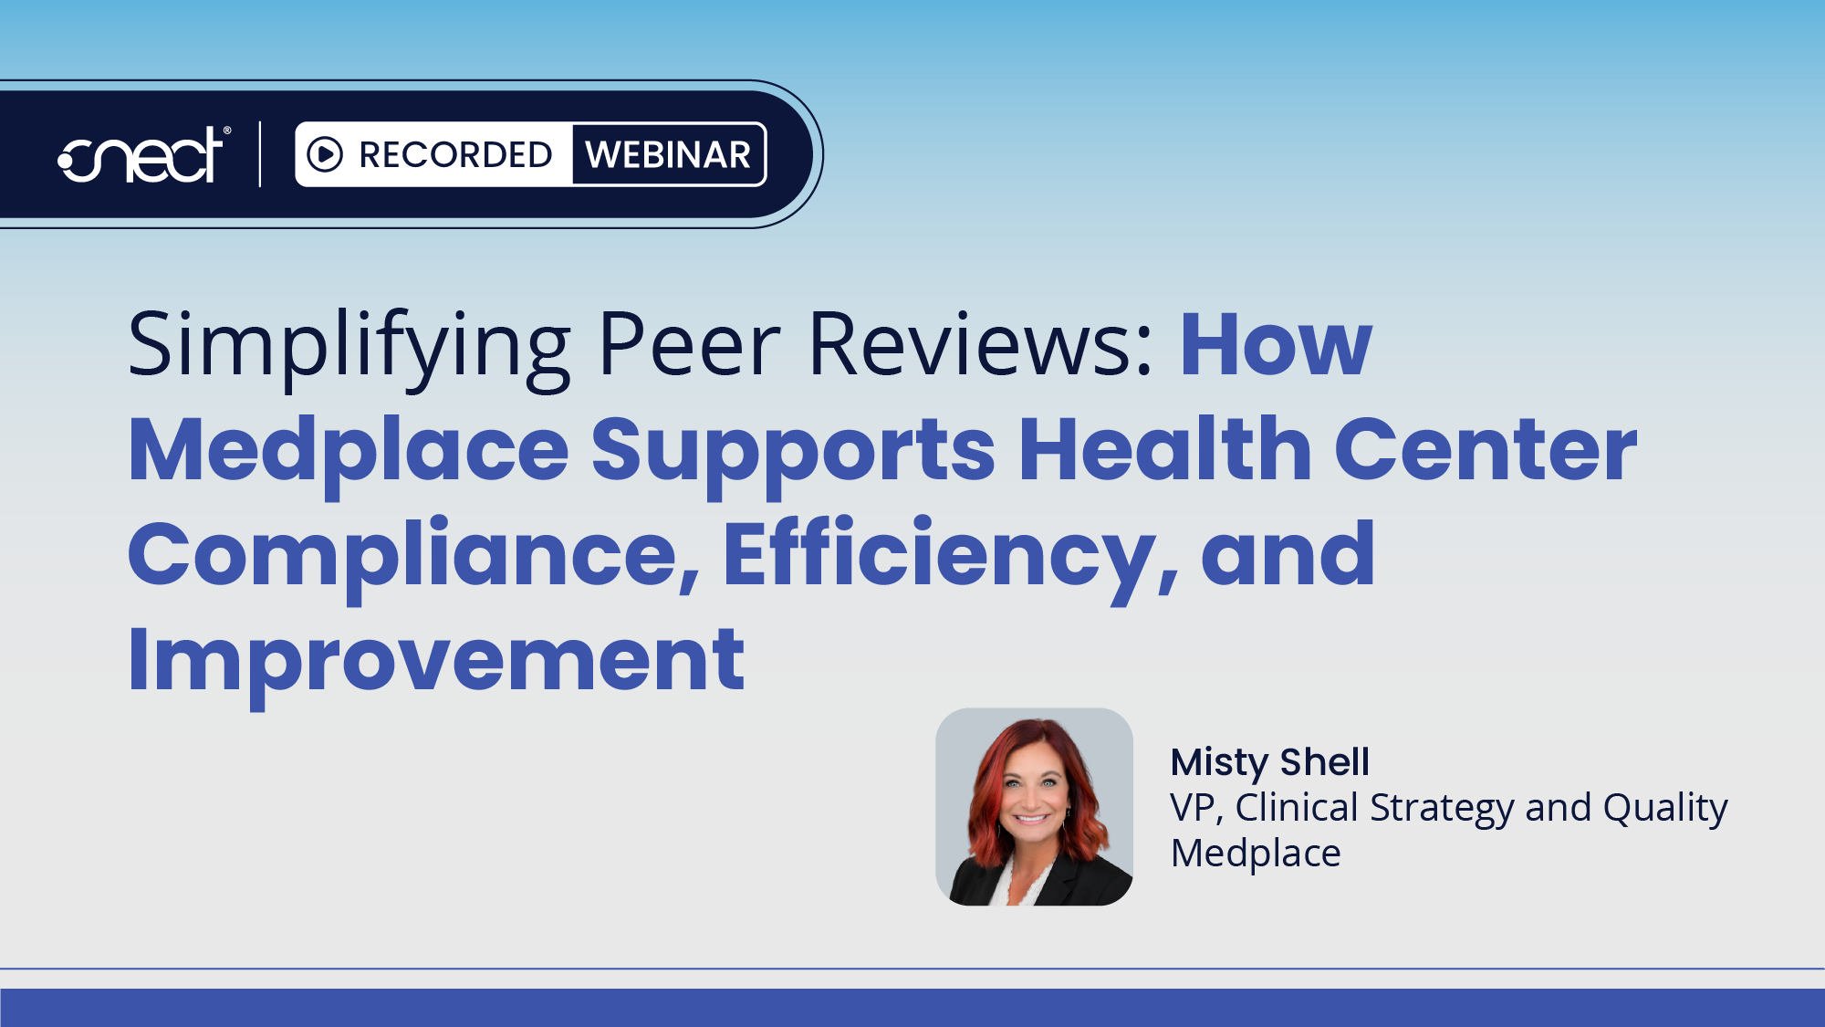
Notes:
Welcome to this CNECT webinar. I’m Bella Tichon, and
Today we’re taking a closer look at how health centers can simplify the clinical peer review process.
CNECT has partnered with Medplace to make peer reviews easier for health centers, combining an external network of practicing specialists with a platform designed to manage the review process.
Today, we’ll take a closer look at how the solution works and what Medplace can offer health centers.
I’m pleased to welcome Misty Shell, VP of Clinical Strategy and Quality, who will walk us through the solution. Misty, I’ll turn it over to you.

Slide 2



Peer Review That Holds Up
What HRSA and FTCA expect — and what changes when you stop doing it in-house.
A CNECT WEBINAR

Slide 3
PART ONE
Why It Matters

Slide 4

Peer review
isn’t optional
COMPLIANCE
HRSA · FTCA
HRSA wants a cadence
Quarterly review, and a policy you follow.
✓
T H E A S K
HRSA Manual Chapter 10
FTCA deeming is annual
Your risk plan has to show it connected.
✓
Accreditation
Joint Commission, NCQA PCMH and AAAHC want the same.
✓

Slide 5




WHY IT WORKS
QUALITY
A quality instrument
It finds gaps
Measures missed because data landed where it didn’t count, not because care was missed.
It feeds QI
Findings flow into report cards, dashboards and PDSA cycles.
It aims the cycle
Point each quarter’s review at whatever your quality data is flagging.
It catches trends
A pattern caught now is a sprint, not next year’s crisis.

Slide 6



A clear roadmap
RISK
WHY IT CUTS RISK
CLAIMS
BIAS
PLAN
The same findings
No stake
Proactive
Where care slips is where FTCA claims come from. One review surfaces both.
External reviewers remove the conflict internal review can’t.
What peer review flags this year belongs in next year’s risk plan.

Slide 7
PART TWO
Peer Review as a Service

Slide 8
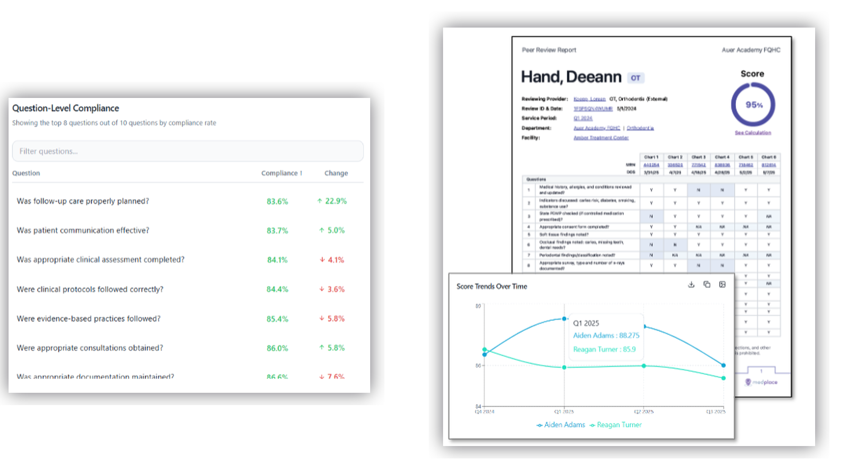




The Medplace
Platform
PEER REVIEW
WHAT YOU GET
Question-level compliance across every provider
Scored reports with reviewer rationale
Score trends over time, by provider and site
One dashboard, export to committee and board

Slide 9



How it works
PEER REVIEW
CONCIERGE
1
2
3
4
Pull Encounters
›
Pick an Expert
›
Scoring
›
Report
On your schedule. No chasing, no email threads. Or have Medplace pull for you.
Specialty-matched, conflict-screened. Read the CV first.
Scored against a template built around your requirements.
Audit-ready and trended,
ready for the board.

Slide 10



PEER REVIEW
WHAT TO EXPECT
By the numbers
130+
Subspecialties in the network
5–6
Charts per quarter
6
Days to report
Providers stay on the floor. Your quality lead stops chasing reviews.

Slide 11
SUMMARY
Four Takeaways

Slide 12
TAKE IT IN
TAKE
Four takeaways
1. Combats bias
Independent reviewers with no stake in the outcome, and no desk three doors down.
2. Supports quality
Findings feed QI, PCMH, payer measures and board reporting.
3. Compliance
A documented quarterly cadence that stands up at an OSV or FTCA review.
4. Time
Providers stay with patients. Your quality lead gets days back.

Slide 13
FREE TOOLS
FOR ATTENDEES
Three free tools
Build a scored form for any specialty. Or price your current program.
medplace.com/tools

Slide 14


QUESTIONS WELCOME
Thank You
Book a demo
›
See pricing
›
If you have any additional questions, kindly reach out to us at:
Try the free form tool
›
sales-inquiry@medplace.com

Slide 15

Thank You!
Next Steps:
Contact your local CNECT representative
Identify savings opportunities together
Start saving!
Contact us:
(800) 640-1662
cnect@cnectgpo.com
Notes:
Thank you Misty for sharing those insights and walking us through the Medplace solution.
Today’s discussion highlighted how an external peer review solution can help health centers simplify the review process while maintaining visibility, quality, and control.
If you’re interested in learning more about Medplace and the clinical peer review services available through CNECT, or would like to explore additional solutions for your organization, please scan the QR code on your screen to connect with our team.
Thank you again for joining us, and take care everyone.

